Slide 1
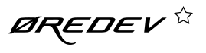
Agile Metrics – Beyond Velocity and Burndowns onto Data Driven Coaching
@t_magennis
Troy.magennis@FocusedObjective.com

Slide 2
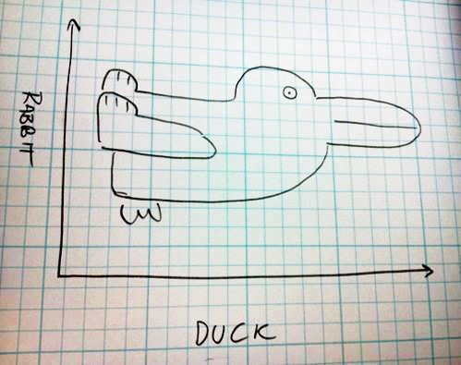

Slide 3
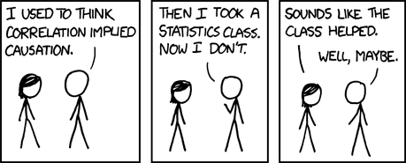
Criteria for causality
The cause precedes the effect in sequence
The cause and effect are empirically correlated and have a plausible interaction
not spurious (one off/inconsistent)
(http://xkcd.com/552/ Creative Commons Attribution-NonCommercial 2.5 License)
Sources: Kan,2003 pp80 and Babbie, 1986

Slide 4
Spurious Correlations: http://tylervigen.com/

Slide 5
Wisely choosing metrics

Slide 7
Don’t Measure Individuals
Measure Team Performance
The Carmelo Anthony effect
Talent has a point of diminishing returns and can even hurt teams
Notes:
Measuring people takes focus off of overall outcomes. It doesn’t matter if you’re praising or shaming.
If you praise people for a particular measure you end up having people focusing on reaching the target rather than having a good outcome for the business. (Goodhart’s Law: “When a measure becomes a target, it ceases to be a good measure.”)
If you embarrass someone, you will never get clean data on that metric ever again. It’s a costly strategy. (“Tell me how you measure me and I will tell you how I will behave. If you measure me in an illogical way… do not complain about illogical behavior” Eli Goldratt)
This implementation is asking for trouble because it makes people value having low idle time on bugs rather than the work that can add the most value to the product. Bugs are not always the most important thing.
Discuss: http://www.scientificamerican.com/article/the-surprising-problem-of-too-much-talent/ - which explains why you might not want to assume awesome individual stats can be tidily summed up to awesome team stats.

Slide 8
Good Metrics
Bad Metrics
Lead to decisions
Within teams’ influence
Gaming leads to “good”
Have a credible story
Are linked to strategy
Trend or distribution based
Leading indicators
Just convenient to capture
Linked to pers. reputation
Gaming leads to “bad”
Doesn’t link to strategy
Individual value based
Trailing indicators

Slide 9
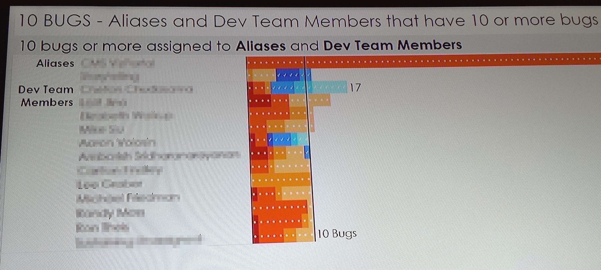
Shaming (or praising) encourages gaming & consequences
“If you measure me in an illogical way… do not complain about illogical behavior” – Goldratt
“Where there is fear, the figures will be wrong”
- Deming
Notes:
Measuring people takes focus off of overall outcomes. It doesn’t matter if you’re praising or shaming.
If you praise people for a particular measure you end up having people focusing on reaching the target rather than having a good outcome for the business. (Goodhart’s Law: “When a measure becomes a target, it ceases to be a good measure.”)
If you embarrass someone, you will never get clean data on that metric ever again. It’s a costly strategy. (“Tell me how you measure me and I will tell you how I will behave. If you measure me in an illogical way… do not complain about illogical behavior” Eli Goldratt)
This implementation is asking for trouble because it makes people value having low idle time on bugs rather than the work that can add the most value to the product. Bugs are not always the most important thing.
Discuss: http://www.scientificamerican.com/article/the-surprising-problem-of-too-much-talent/ - which explains why you might not want to assume awesome individual stats can be tidily summed up to awesome team stats.

Slide 10

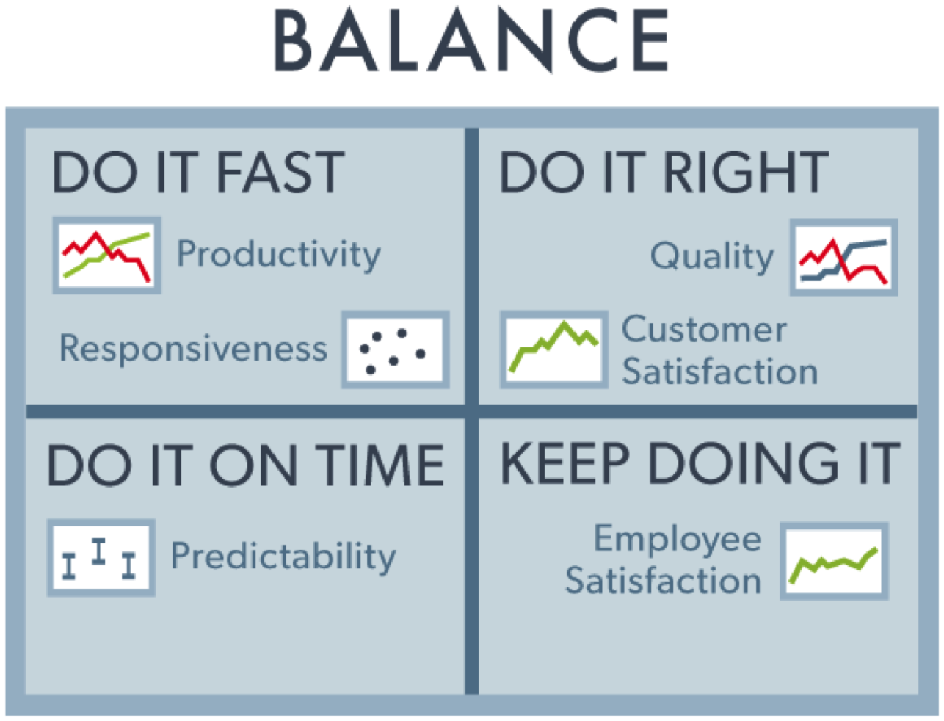
Balanced Metrics

Slide 11
What makes a good metric?
Is relavent to the team or individual - personalized
To compare against others, and to see progress
Is within the teams ability to move (or get moved)
Has value in being diagnostic
Passively captured (low cost and effort)
Look for cheapest correlated metric to a more costly metric where possible
Balances another metric – demonstrates tradeoff and impacts
Look for cheapest metric that will likely be negatively impacted by movement of another mentric

Slide 12
What?
So What?
Now What?

Slide 13
Purpose of coaching dashboards
Improvement – what to change
To help teams identify their weakest area comparable to other teams in similar circumstances
To confirm improvement has been achieved after a process change experiment
To identify what was traded to achieve that improvement
Avoidance – what to watch (sense)
To identify what internal team factors most disrupt team momentum
To identify what external factors most disrupt team momentum

Slide 14
“My Team” Diagnostics Coaching Dashboard

Slide 15


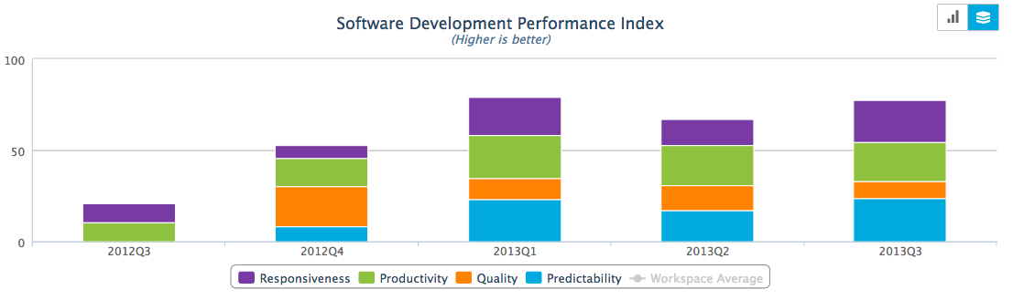
SDPI Dimensions
Productivity = throughput avg / team size
Predictability = variability of throughput / size
Responsiveness = time in process average
Quality = released defect density / throughput
The Software Development Performance Index
The SDPI framework includes a balanced set of outcome measures. These fall along the dimensions of Responsiveness, Quality, Productivity, Predictability, …
Example, team over time -
Source: Rally Dev.

Slide 16
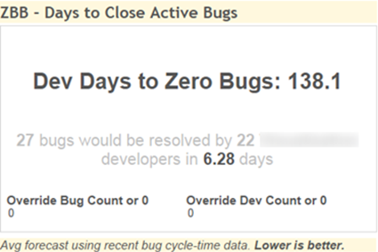
Quality
“If OUR entire TEAM did nothing else but fix bugs this sprint at our historical rate, we would have x days of work”
Goal is to keep the teams within 10 days of releasable
Forecast has to be personal for the team
Days = Open Bugs x Avg(recent cycle time samples) Number of Devs on team
Replaced:

Slide 17
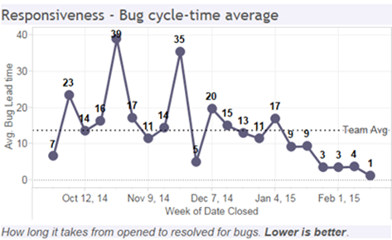
Responsiveness
Average or median of the number of days between two dates for items closed within a period
Cycle time or Lead time of ???
If reliable first touch date, use that
If just created date, then use P1 and P2 bug
“If something urgent comes along, how fast can we turn that around”

Slide 18
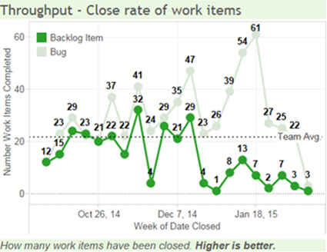
Completion Rate
“What is holding us back on completing more. Lets discuss dependencies and blockers in the retrospective”
Team goal is to maximize number of COMPLETED items, not started items
Count of items completed each period
Don’t celebrate bug throughput (as much)

Slide 19
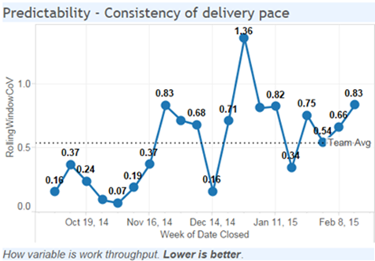
Predictability
How much variation there is each week in throughput, normalized by “team size” in a rough way
Coefficient of Variation = Mean/SD
“How consistently do we deliver value?”

Slide 20
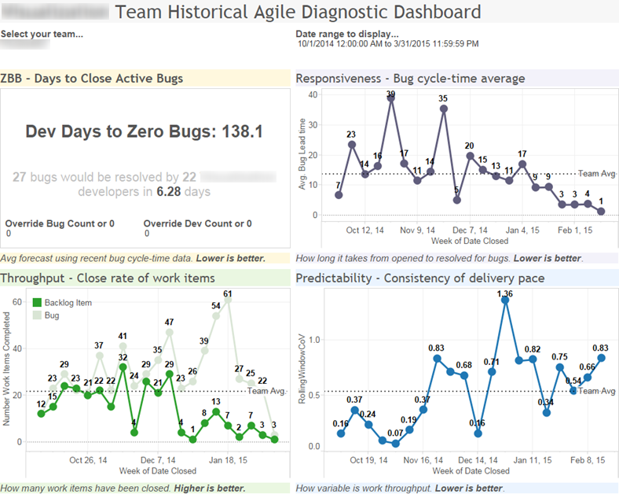

Slide 21
Sure, but what data did you need?
Date started (committed to do)
Date completed (in main brance and switched on)
Story or Defect flag
Who is doing the work (for team size)

Slide 22
My Team vs Similar Dashboard

Slide 23
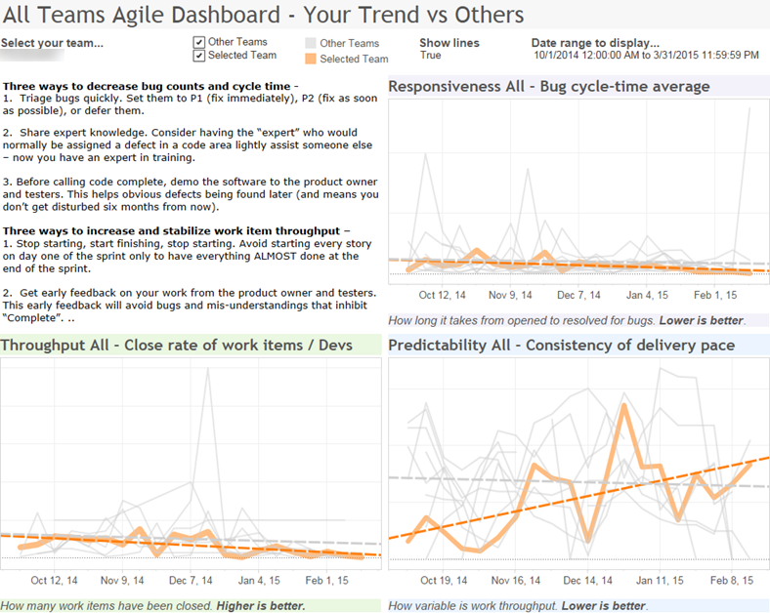
No Y-Axis!
Trends NOT Measures
Coaching advice
Still has value when noisy data…
Compare against others

Slide 24
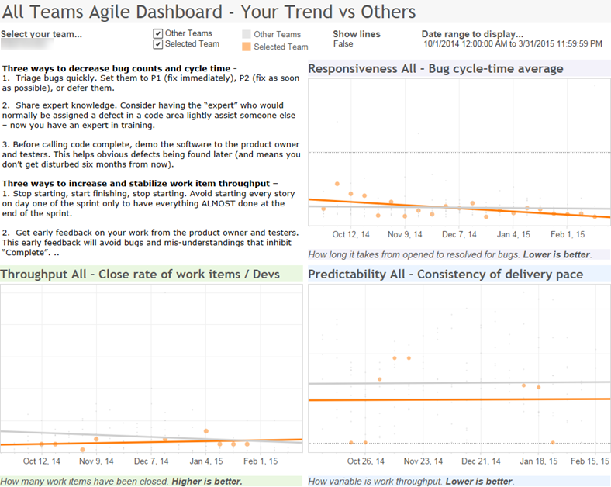
Team A
Started worse, but corrected
Parallel and better
Improving, against company trend

Slide 25
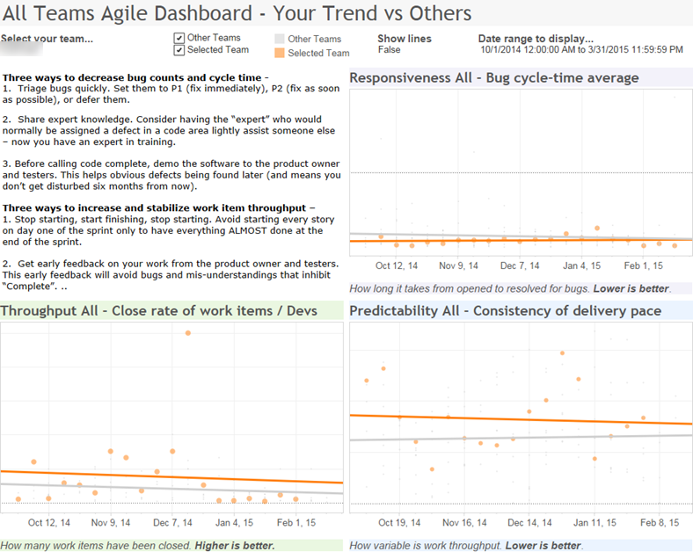
Team B
Creeping up…
Oops. Still good, but trending adversely
Better and with company trend

Slide 26
Explore the detail
Make the data available for exploration….

Slide 27
Sure it looks good, but is it *useful*

Slide 28
Why not just a simple column chart?
Goals
See WIP values by date
See WIP trends over time
Column chart for values
Line chart for trends over time

Slide 29
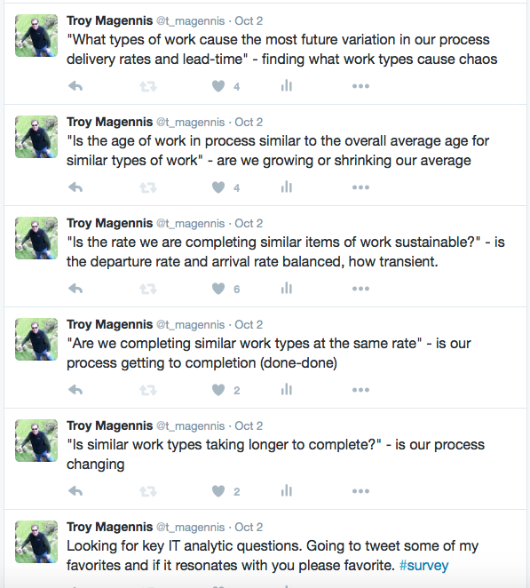
2
2
1
3
3

Slide 30
Sometimes: Simple is better
Forecasting needs throughput by week. CFDs don’t really give you the values….

Slide 31
Are we starting or finishing more per week?
If its about incentivizing finishing rather than starting, perhaps this chart motivates

Slide 32
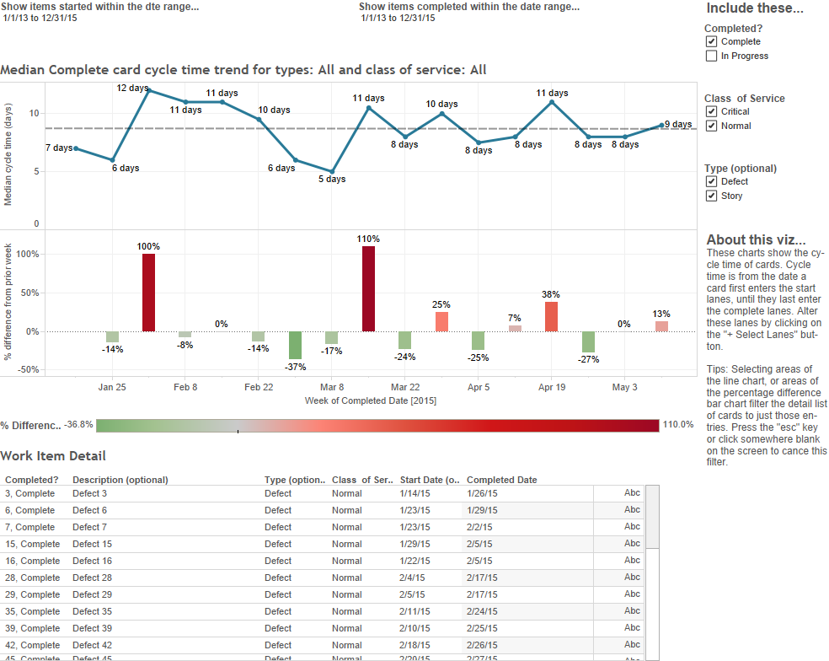

Slide 33
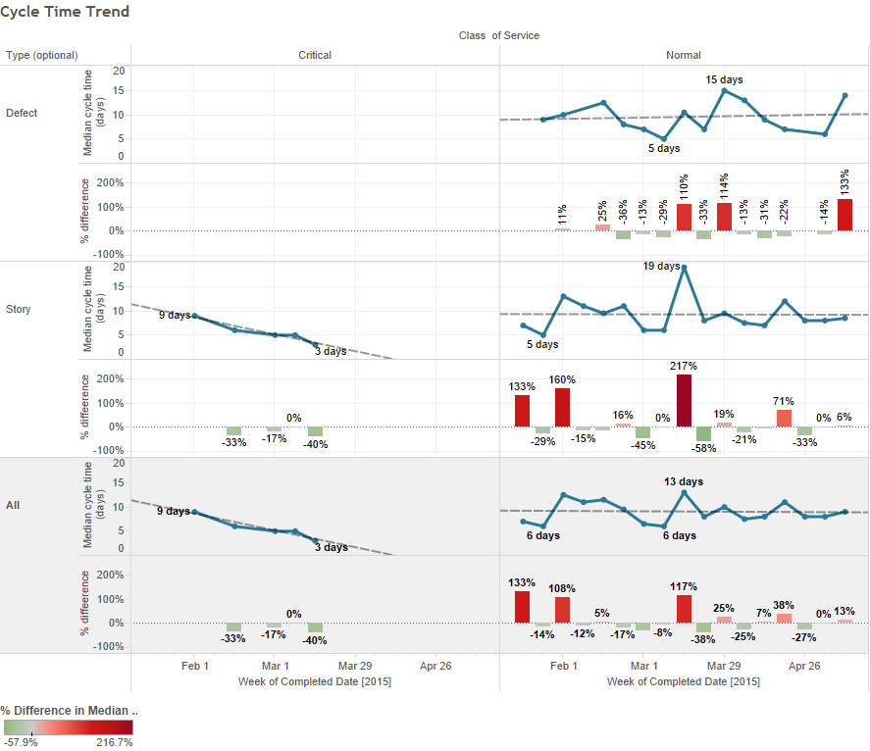
Small Multiples – arrays of things vs things

Slide 34
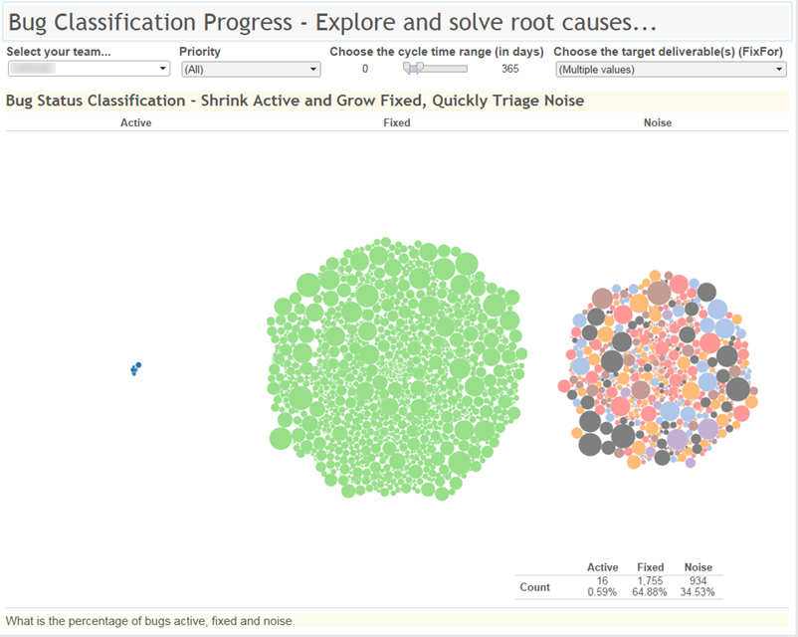
Leftmost – important, and needs to stay small
Central and green to celebrate
Not teams fault, noisy reporting process (necessary)

Slide 35
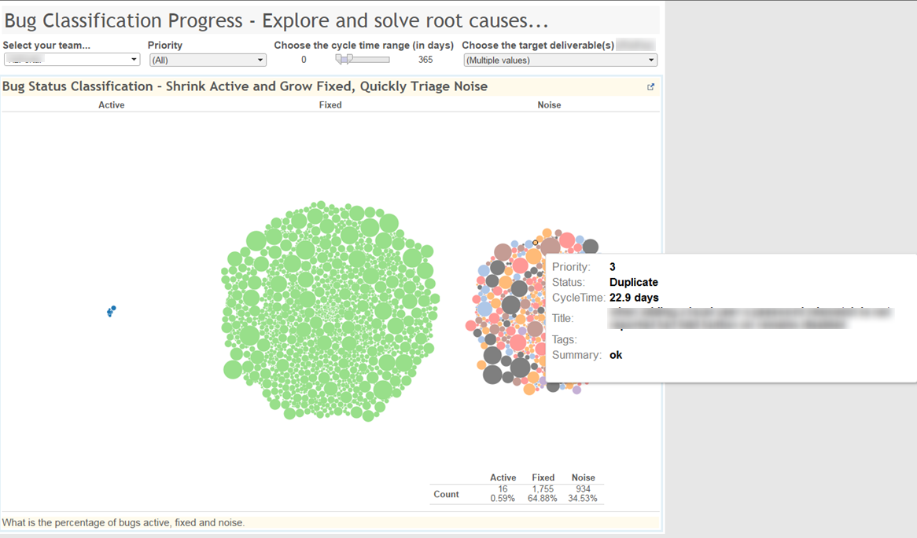
Teams naturally sampled the dots and discussed improvements
Interactivity invites exploration

Slide 36
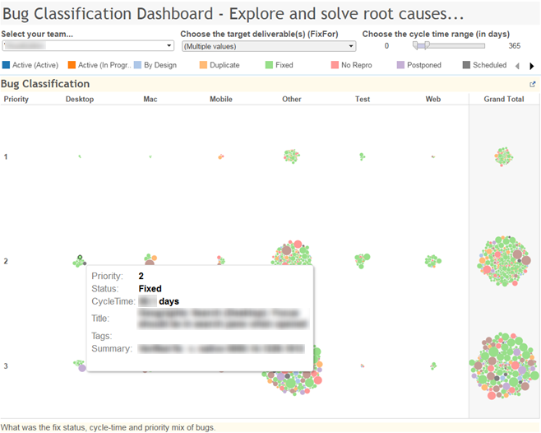

Slide 37
Cycle time analysis

Slide 38
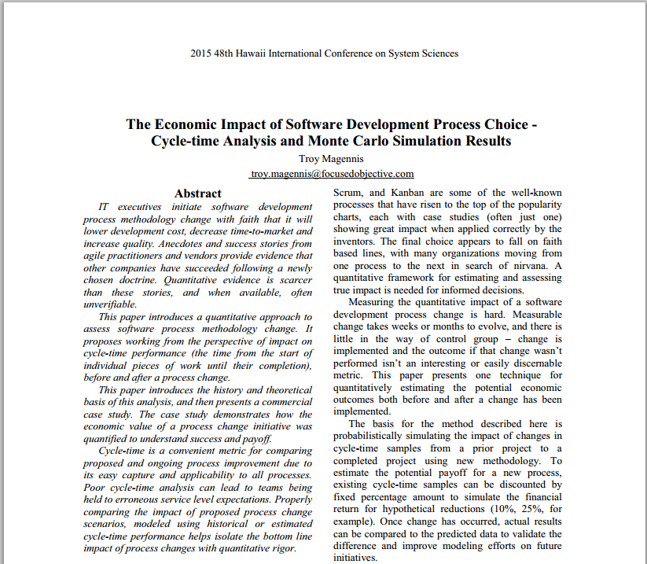
Paper: Impact of Process on Cycle Time
“IT executives initiate software development process methodology change with faith that it will lower development cost, decrease time-to-market and increase quality. Anecdotes and success stories from agile practitioners and vendors provide evidence that other companies have succeeded following a newly chosen doctrine. Quantitative evidence is scarcer than these stories, and when available, often unverifiable”
http://conferences.computer.org/hicss/2015/papers/7367f055.pdf

Slide 39
Where we are…
Agile development process choice faith based
Anecdotal (success stories), certification driven
Verifiable quantitative evidence elusive
Rarely controlled
Un-balanced metrics – negative impacts not noted
Metrics and techniques from 1970 & 80’s
Hair styles changed more than management ideas
Metrics & statistics borrowed from manufacturing
Deming, Goldratt, Shewhart, Poppendick(s)
The problems isn’t that it was done
its that we are still doing it!
Paper: http://bit.ly/14eYFM2

Slide 40


1997: Industrial Strength Software
by Lawrence H. Putnam , IEEE , Ware Myers
2002: Metrics and Models in Software Quality Engineering (2nd Edition) [Hardcover]
Stephen H. Kan (Author)
Paper: http://bit.ly/14eYFM2

Slide 41
1970-1990’s
Waterfall
Rayleigh Distribution, Weibull shape parameter = 2
Approx 2000
Weibull shape parameter = 1.5
Approx. 2008
Lean
Weibull shape parameter = 1.25
Approx 2010
Exponential Distribution, Weibull shape parameter = 1
Cycle Time in Days
Work Item Cycle Time or Lead Time Distribution Through the Ages
Paper: http://bit.ly/14eYFM2

Slide 42
Introducing – Weibull Distribution
Shape parameter (how bulbous)
Process factors
Batch size / Sprint length
Scale parameter (63% Values Below)
Paper: http://bit.ly/14eYFM2

Slide 43
Why is this interesting?
NOT necessary for forecasting, use actual samples
Data integrity checking
Is data captured with integrity?
Actual future historical data following expected probabilities?
Does the described process match what we expect
Avoid over-fitting?
“Better” Expert estimation (no data available)
Fit Weibull to 2 probability estimates to find long-tail impacts
E.g. “3 out of 10 stories less than 1 week, 8 out of 10 stories less than 2 weeks”
Paper: http://bit.ly/14eYFM2

Slide 44
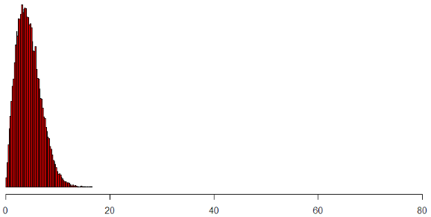
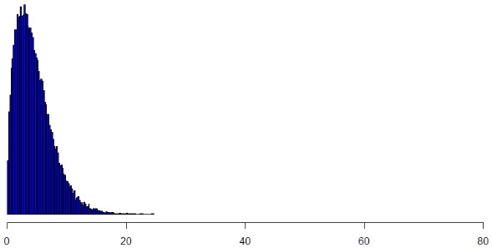
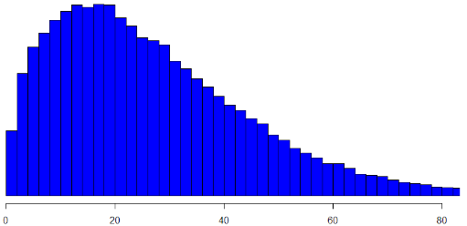
Shape = 2
Process \ External Factors
Shape = 1.5
Batch Size / Iteration Length
Shape = 1
Scale = 5
< 1 week
Scale = 15
~ 2 week sprint
Scale = 30
~ 1 month
Work Item Cycle Time or Lead Time

Slide 45
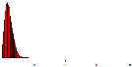
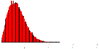
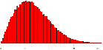
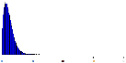
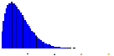

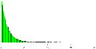
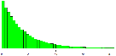
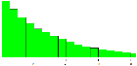
Lean, Few dependencies
Sprint, Many dependencies
Higher work item count
More granular work items
Lower WIP
Team Self Sufficient
Internal Impediments
Do: Automation
Do: Task Efficiency
Lower work item count
Chunkier work items
Higher WIP
External Dependencies
External Impediments
Do: Collapse Teams
Do: Impediment analysis
Paper: http://bit.ly/14eYFM2

Slide 46
Traits:
Small unique work items. Medium WIP. Few external impediments. Fair predictability.
Traits:
Larger unique work items. High WIP. Low predictability. Many external dependencies.
Process advice: Focus on identification and removal of impediments and delays, and quality. Scrum optimal.
1.3 to 2 (Weibull Range)
Weibull Shape Parameter
Traits:
Small or repetitive work items. Low WIP. Few external dependencies. Good predictability.
Process advice: Automation of tasks, focus on task efficiency. Lean/Kanban optimal.
Traits:
Larger work items. Large WIP. Many external dependencies. Poor predictability.
1 to 1.3 (Exponential Range)
0 to 10
10 to 30
Weibull Scale Parameter

Slide 47
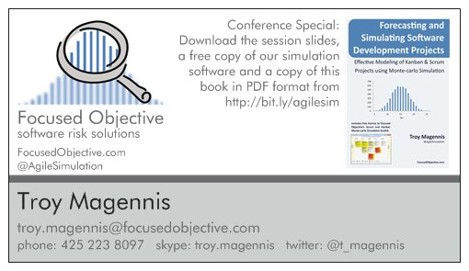
Paper: http://bit.ly/14eYFM2
Notes:
My name is Troy Magennis, I’ve been in software for 25 years now, from QA through to VP Architecture and Development for companies like Travelocity and Lastminute.com. Most recently I formed my own company building tools and running training on software development forecasting and risk management solutions. Feel free to take notes, but the slides and examples are available to you online. And as a special benefit for joining us today, you can download the software used throughout this session for free. Bit.ly/agilesim will take you to the right site. I wrote a book about these topics, “Forecasting and Simulating Software Development Projects” and I’d like to make sure you all got a free PDF copy of this book also. Just download it from the same location.

Slide 48
Spurious Correlations: http://tylervigen.com/

Slide 49
Contact Details
www.FocusedObjective.com
Download latest software, videos, presentations and articles on forecasting and applied predictive analytics
Troy.Magennis@focusedobjective.com
My email address for all questions and comments
@t_magennis
Twitter feed from Troy Magennis
Paper: http://bit.ly/14eYFM2

Slide 50
Moving one metric is easy. Moving a metric without impacting at least one of the others is HARD!
VALUE
TIME
QUALITY

Slide 51
Analytics are expensive
Invest wisely
Descriptive - statistics
Prepares and analyzes historical data
Answers “What happened?” and “Why?”
Predictive – big data
Predicts future probabilities & trends
Answers “What will happen?”
Prescriptive – big human brains
Finds better ways to operate
Focuses on objectives, balances constraints
Answers “What should happen?”
Notes:
Analytics is over-used.
We are showing why to use each kind or how to identify what kind of metric something is. (could this be looked at as a good, better, best scenario?)
The value of coaching lies in defining, creating and interpreting prescriptive metrics and then translating those to action. Each metric should be actionable.
Each metric should be created with intent. Know why you are measuring something or stop measuring it.
Transition to next set of slides:
========================
Because measuring is dangerous and expensive, let me tell you how measuring can go wrong.
“Don’t run with sharp metrics”

Slide 52

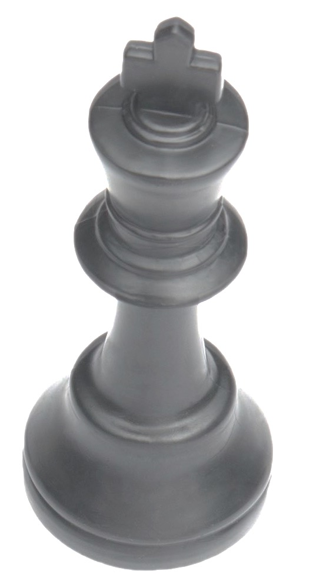
Avoid vanity metrics
Challenge each metric by asking “So What?”
# of Tickets
closed
System Uptime
Instead, measure
Instead, measure
Customer Outage Impact Cost
Ability to quickly respond to needs (MTTR, etc.)
Business Value Delivered
Customer Satisfaction
Notes:
Measures activity – confuses activity with progress towards goals. It might be interesting, but generally not actionable.
These metrics failed the so what test!
Uptime can be variable – defined differently in each scenario. defined differently - planned uptime during peak hour. What did you lose? customer revenue, value lost. show instead customer impacts, revenue lost, etc.
3. Regarding Uptime:
IMO your customers are more upset by a botched recovery than experiencing an unexpected downtime. They know downtime happens. They expect a quick recovery.
Some people are afraid to admit that their services can go down. Avoiding reality is never a good strategy. Admit you will experience an outage at some point and work to reduce MTTR.
If you focus on increasing your MTBF while decreasing your MTTR then you are likely to have happy customers.
The Mean Time to Resolve issues (MTTR) is the primary measure that Operations teams use to determine their effectiveness in dealing with problems. (http://apmdigest.com/5-it-operations-challenges-%E2%80%93-and-1-main-cause)
What I’m definitely not saying is that failure should be an acceptable condition. I’m positing that since failure will happen, it’s just as important (or in some cases more important) to spend time and energy on your response to failure than trying to prevent it. (http://www.kitchensoap.com/2010/11/07/mttr-mtbf-for-most-types-of-f/)
Third party resources studied:
http://fourhourworkweek.com/2009/05/19/vanity-metrics-vs-actionable-metrics/
http://www.slideshare.net/energizedwork/mtbf-mttr
https://www.pagerduty.com/blog/operational-metrics/

Slide 53
Source: http://junkcharts.typepad.com/junk_charts/junk-charts-trifecta-checkup-the-definitive-guide.html

Slide 54
OK, it’s a dramatic title, but what’s your point
Cumulative Flow Diagrams are commonly taught and implemented
I think they are harder to read than necessary for the info they yield
Looking for alternatives that can be read and understood without instruction or popup interactive support
CFDs have their purpose, but shouldn’t be our only tool
I want to expand the charts and provide real advice on their use
I want to avoid the known issues of using stacked area charts
I want to help find WIP, Cycle Time, and Throughput relationships

Slide 55
Why is it useful?
To see trends in work (WIP) growth/decline in buffers/queues
To approximate average cycle-time using “Horizontal Line” estimation
For average to be close, the assumptions are:
Work completes in the order it starts
No impediments impacting one item but not others
To approximate throughput and demand
The slope of the Completed top edge is approximate average throughput
The slope of the Ready top edge is approximate average input demand
To forecast remaining time by extending the Completed top edge until it intersects the remaining work…
Only if all work is already known and in backlog,
or the growth rate over time approximated…

Slide 56
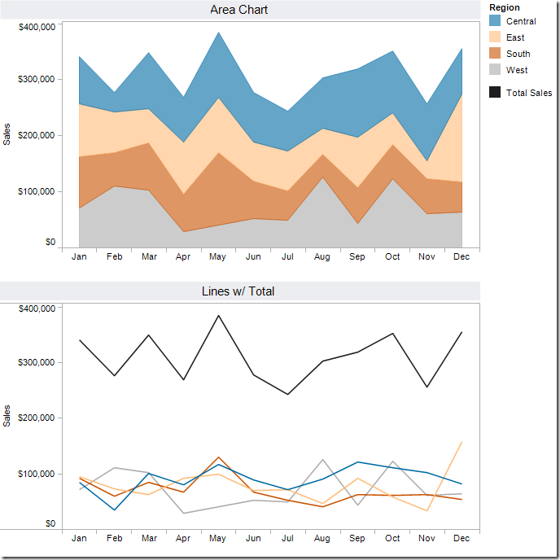
Simple Alternative?
Exercise
Using the top chart alone
Who had the best May peak?
By how much?
Who had the best Oct peak?
If we are interested in total
We can read the top of the blue
Or we can just use a line
If we are interested in region contribution
Use a line chart starting at the same Y axis value
Use a column bar chart with adjacent bars so you can compare the peaks

Slide 57
Issue – Column WIP Value by Date Impaired
The stacked nature means estimating the relative size of band versus band for the same date is impaired
Our eyes tend to focus on the tops of each line, leading to misinterpreting the patterns because we don’t adjust for the non-flat base.
It’s nearly impossible for us to translate the width of each color (i.e., the actual value) into an accurate trend. This is because the pattern of each color is influenced by the colors below it.
http://vizwiz.blogspot.com/2012/10/stacked-area-chart-vs-line-chart-great.html?m=1
Giveaway: When popup-balloons are needed to give measurements on hover, its clear the chart is failing at communicating values clearly – charts should be self-standing, but enhanced with popups not impossible to interpret without interactive popups.

Slide 58
Go to: Bit.ly/SimResources
Many tools for forecasting and metric analysis
Throughput and Cycle Time Calculator.xlsx
From start and complete date, produces all charts in this presentation
Requests you to submit anonymous data for research purposes
https://github.com/FocusedObjective/FocusedObjective.Resources/raw/master/Spreadsheets/Throughput%20and%20Cycle%20Time%20Calculator.xlsx
The charts shown later are from this spreadsheet

Slide 59
Cumulative flow vs Line chart
Identical data. Sure, I just have one column, but try and guess throughput and cycle time in each chart. Which one is easier?
Notice, very low relationship WIP to cycle time. Items not completed in order they are started, so Little’s law only loosely applies.

Slide 60
WIP Trends – See min, max and average
If we are looking for people controlling WIP, showing the min and max range highlights whilst low on average, we have oscillations…

Slide 61
Demand versus Throughput
By putting demand and completed work side by side we can see a better picture of capacity

Slide 62
In putting this framework together, I aimed to make it simple to use and broadly applicable. The Trifecta Checkup involves only three investigations:
What is the QUESTION?
What does the DATA say?
What does the VISUAL say?
Ideally, the results of all three investigations are one and the same.
***
The Question occupies the top corner because any data visualization project needs a worthy cause. I'd like the Question to be well-posed, and interesting; the former focuses the search for appropriate data while the latter ensures an engaged audience.
The Data should be relevant to the Question being addressed. Relevance can often be augmented by reducing noise, removing errors or transformations.
The Visual elements should represent the Data in a clear, concise manner, addressing the Question directly.
The tradition of Tufte is heavily focused on the Visual corner of the Trifecta, including its linkage to the Data corner. As will be discussed later, it is possible to select the right graph for the data but the project to fail because the data do not solve the posed question.

